Slide 1

Apache Storm
Dima Ionut Daniel

Slide 2
Contents
What is Apache Storm?
Features
Architecture
Components
Basics
Core
Cluster
Conclusions
Bibliography

Slide 3

What is Apache Storm ?
Apache Storm is a distributed processing computation framework written in Clojure.
Apache Storm is developed under the Apache License.
It uses custom created "spouts" and "bolts" to define information sources and manipulations to allow batch, distributed processing of streaming data.
A Storm application is designed as a "topology" in the shape of a directed acyclic graph(DAG) with spouts and blots acting as the graph vertices.
The topology acts as a data transformation pipeline.

Slide 4
Features
Easy to use
Support for multiple programming languages
Fault-tolerant: the storm cluster takes care of workers going down, reassigning tasks when necessary.
Scalable:
Reliable: all messages are guaranteed to be processed.
Fast
Transactional

Slide 5
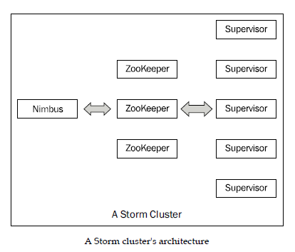
Architecture

Slide 6
Components
A storm cluster follows master-slave model where the master and slave processes are coordinated using Zookeeper.
The Nimbus node is the master in a Storm cluster.
Nimbus is stateless and stores all data in Zookeeper.
There is a single Nimbus node in a Storm cluster.
Supervisor nodes are the worker nodes in a Storm cluster.
Storm uses Zookeeper cluster to coordinate various processes.

Slide 7
Components (cont.)
The basic unit of data that can be processed by a Storm application is called a tuple.
Each tuple consists of a predefined list of fields.
The value of each field can be a byte, char, float, long, double, etc.
A tuple is dynamically typed and we need to define only the names of the fields and not their data type.

Slide 8
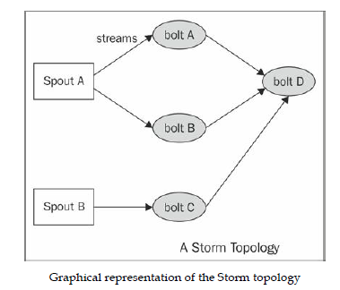
Components (cont.)
A Storm topology is an abstraction that defines the graph of the computation.
We create a Storm topology and we deploy it on a Storm cluster to process the data.
A topology can be represented by a direct acyclic graph where each node does some kind of processing and forwards it to the next node in the flow.

Slide 9
Components (cont.)
A stream is an unbounded sequence of tuples that can be processed in parallel by Storm.
Each stream can be processed by a single or multiple types of bolts.
A spout is the source of tuples in a Storm topology.
It's responsible for reading or listening to data from an external source and publishing them (emitting, in Storm terminology) into streams.
A spout can emit multiple streams.
A bolt is the processing unit of a Storm topology and is responsible for transforming a stream.

Slide 10
Basics
The input stream of a Storm cluster is handled by a component called a spout.
The spout passes the data to a component called a bolt, which performs transformation.
A bolt persists the data in some sort of storage or passes it to other bolt.
Storm can be used for :
Processing streams
Continuous computation
Distributed RPC
Real time analytics

Slide 11

Basics (cont.)
In a Storm cluster, nodes are organized into a master node that runs continuously.
There are 2 kind of nodes in a Storm cluster: master and worker nodes.
Master node runs a daemon called Nimbus which is responsible for distributing code around the cluster, assigning tasks to each worker nodes and monitoring for failure.
Worker nodes run a daemon called Supervisor which executes a portion of a topology.
A topology in Storm runs across many worker nodes on different machines.
Storm keeps all cluster states either in Zookeeper or on local disk.
Underneath Storm makes use of zeromq.

Slide 12
Core
Storm can run in 2 operation modes:
Local Mode
- used for development, testing and debugging
Remote Mode
- used in production

Slide 13
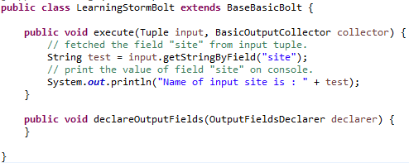
Core (cont.)
The spout emits a continuous stream of records.

Slide 14
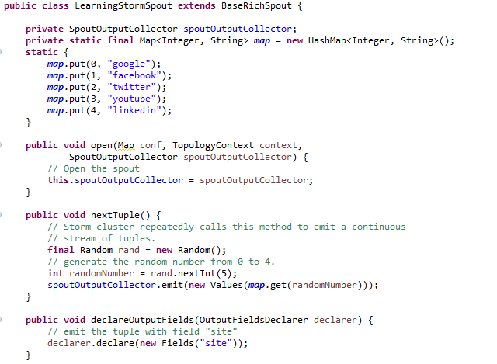
Core (cont.)
The bolt will consume the tuples emitted by the spout.

Slide 15
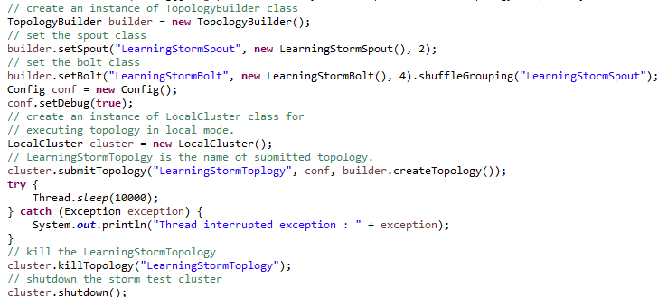
Core (cont.)
TopologyBuilder is used to create the Storm topology.

Slide 16
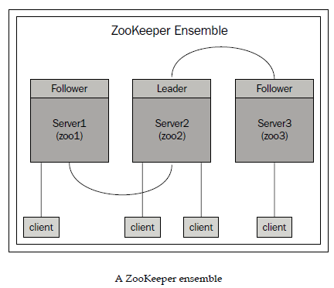
Cluster
It's advised to run odd number of ZooKeeper nodes.
One node in the cluster acts as a leader while the rest are followers.
If the leader node dies then an election for the new leader takes place among the remaining nodes.

Slide 17
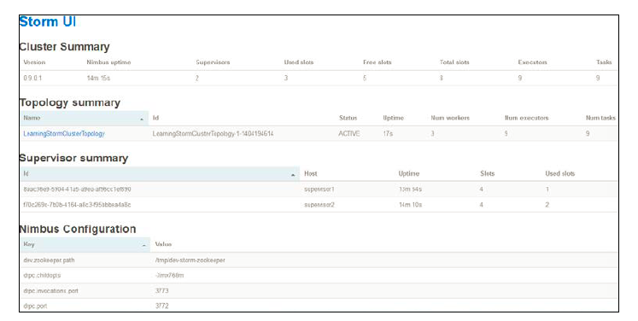
Cluster (cont.)
We can monitor the cluster by starting the UI: bin/storm ui.
By default the Storm UI starts on port 8080 a GUI that can be accessed: http://nimbus-node:8080.

Slide 18
Conclusions
Apache Storm is good for distributed processing.
It can be integrated with many technologies like Apache Kafka.

Slide 19

Bibliography
https://en.wikipedia.org/wiki/Storm_(event_processor)
Oreilly - Getting started with Storm
Packt Publishing – Learning Storm

